Slide 1

Splash Screen

Slide 2

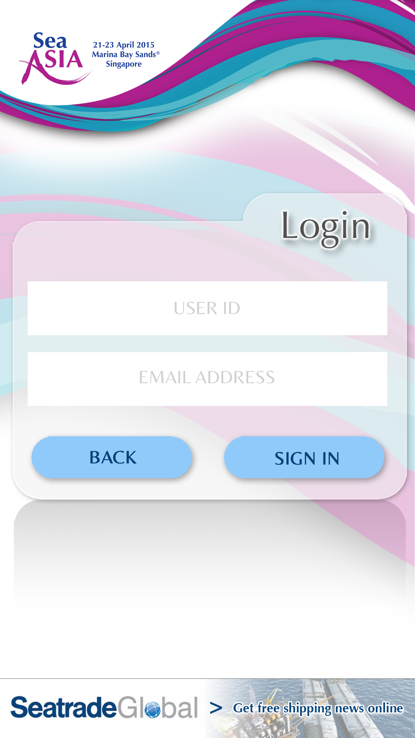


Login Screen (Visitor)
Login Screen (Exhibitor/Delegate)

Slide 3




Homepage
News

Slide 4
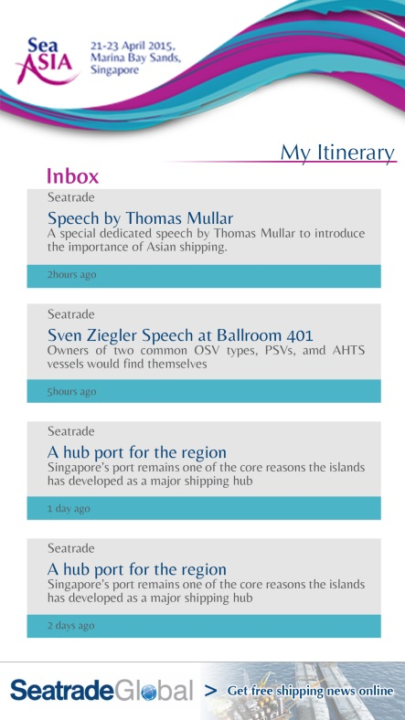

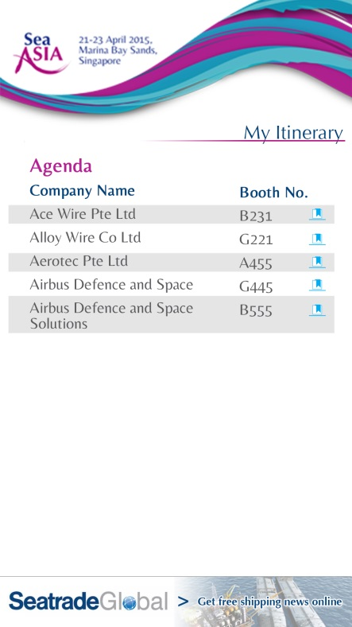
My Itinerary (Inbox)
My Itinerary (My Agenda)

Slide 5

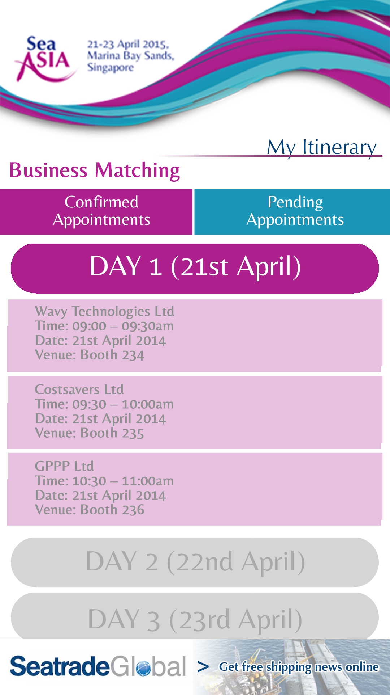
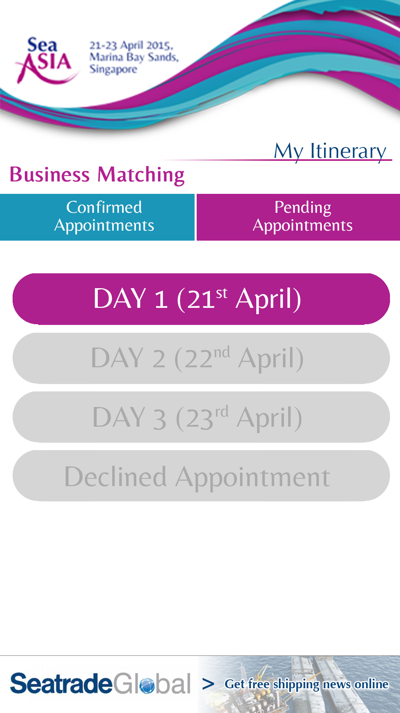
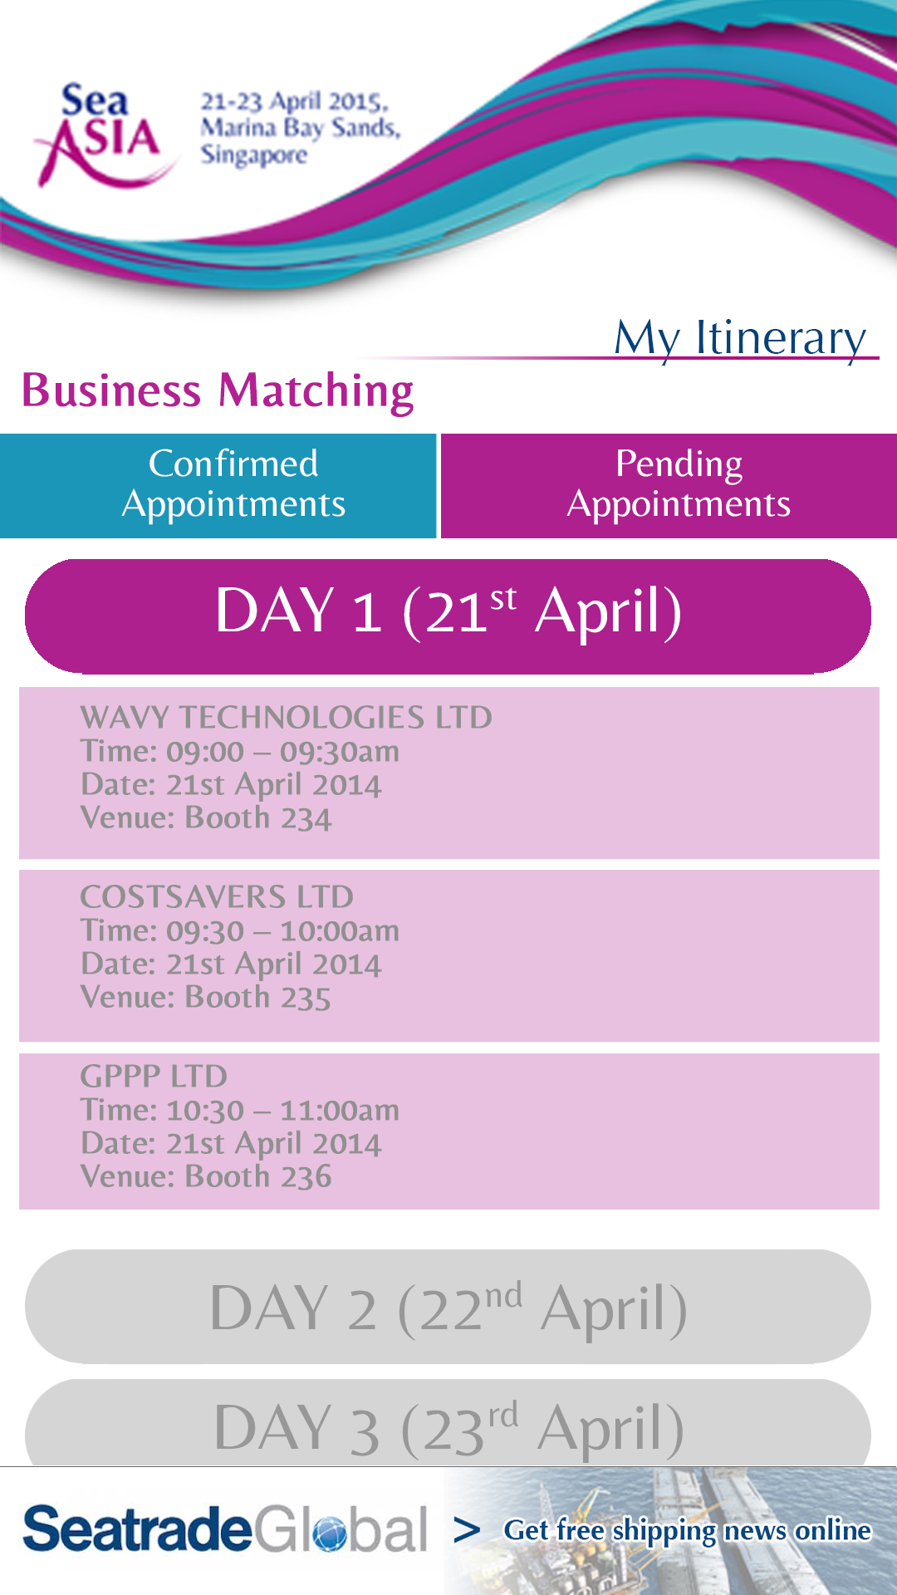
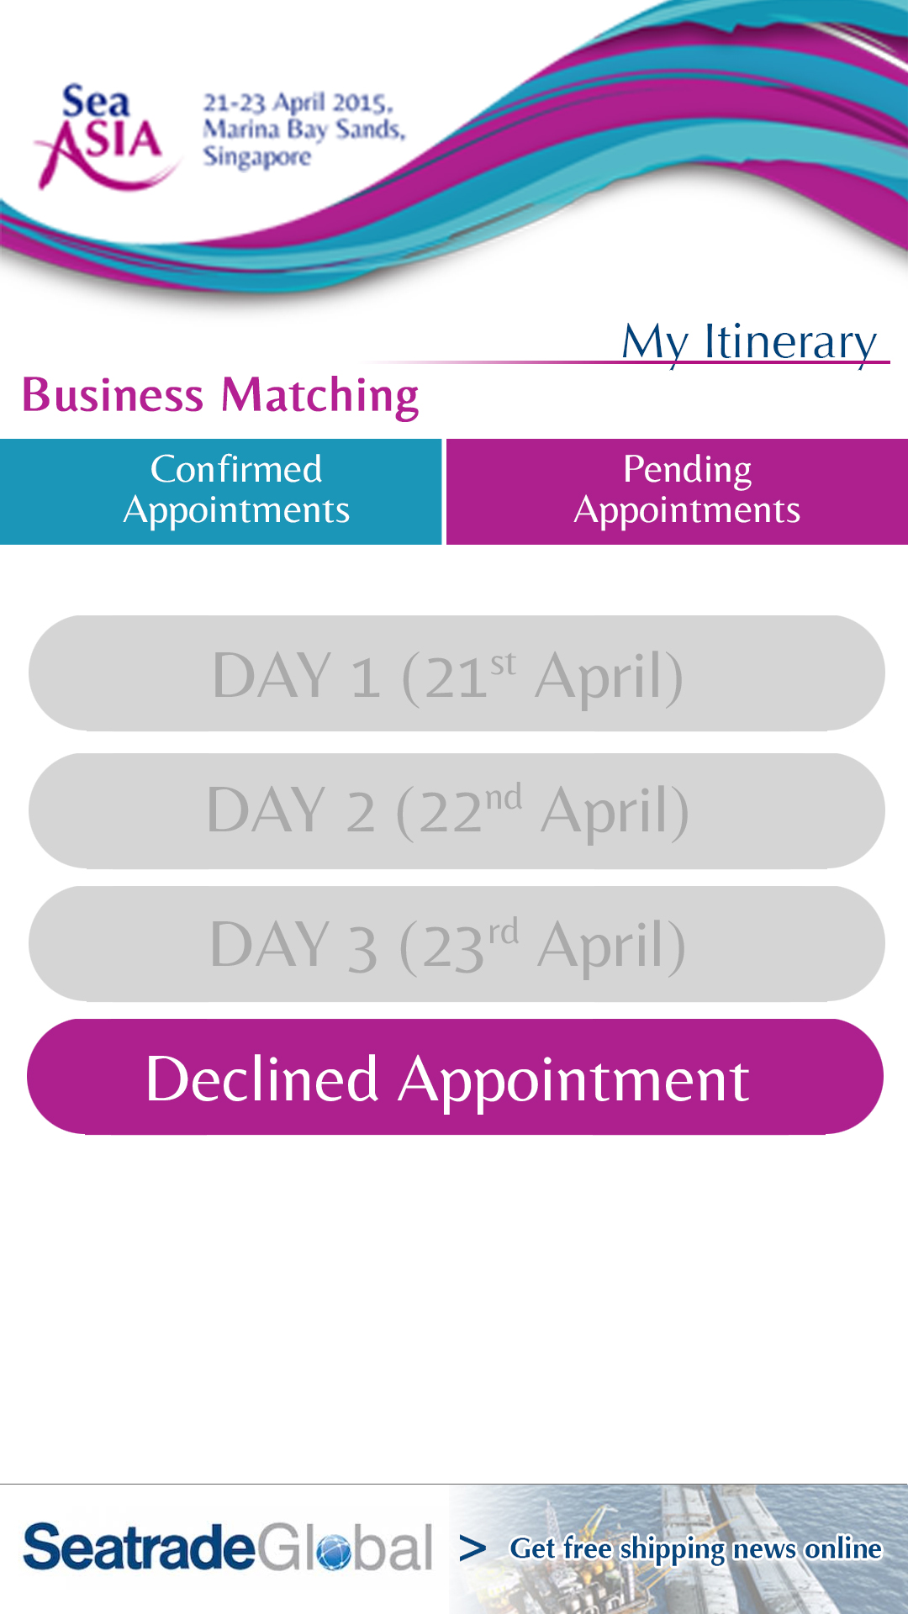
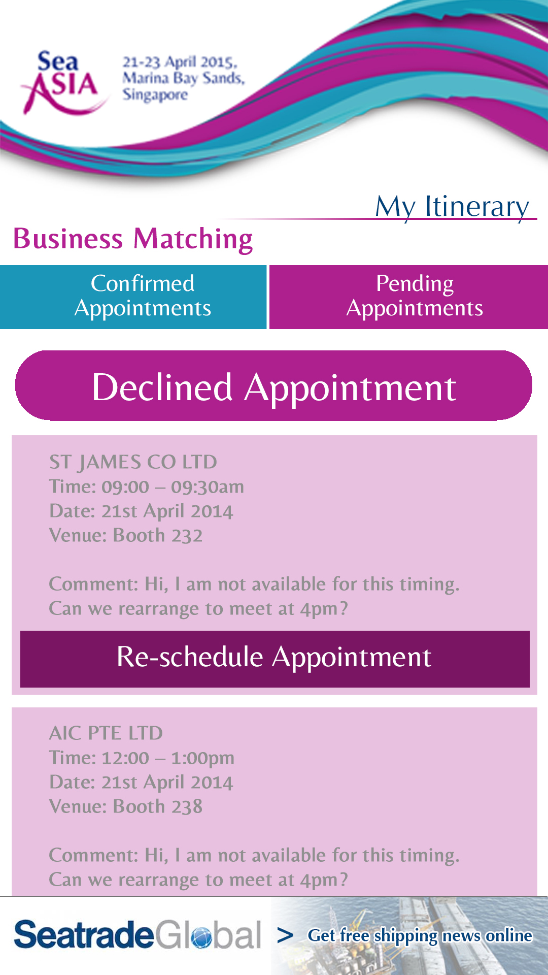
My Itinerary – Visitor/Delegate login
(Business Matching)

Slide 6



My Itinerary – Exhibitor login
(Business Matching)

Slide 7


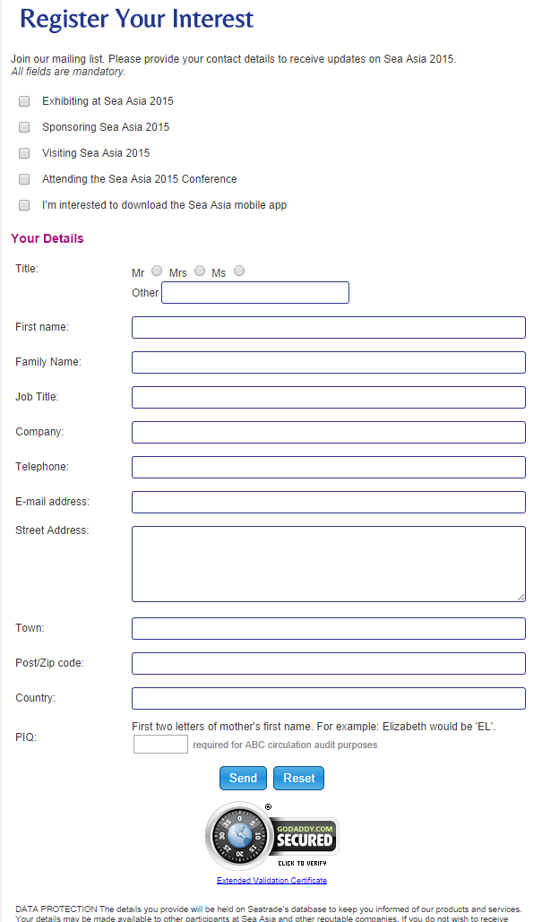
Event Schedule
(Full Schedule)
Event Schedule
(Event Registration)
链接至客户网站

Slide 8


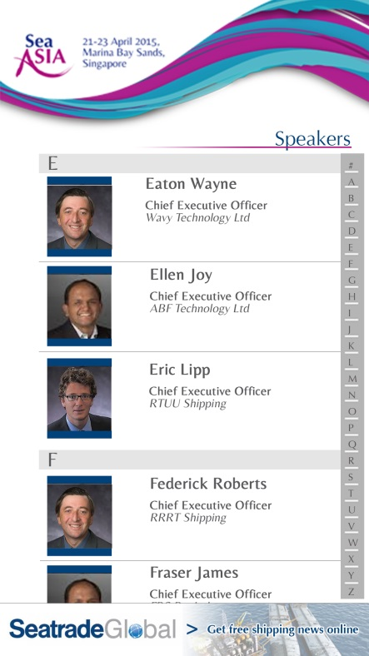
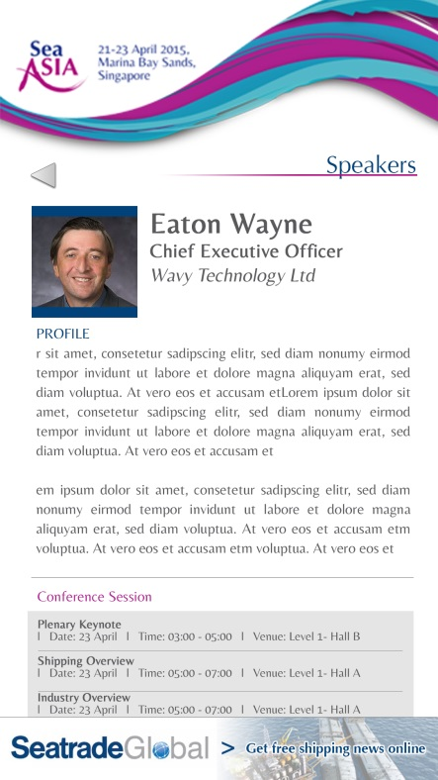
Conference
(Conference Schedule)
Conference
(Speaker)

Slide 9
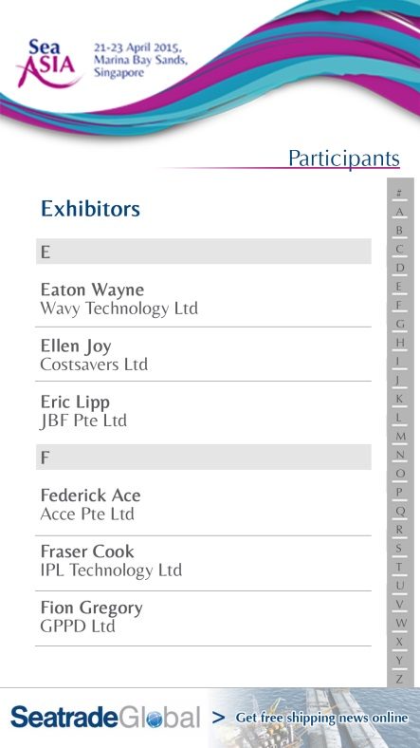

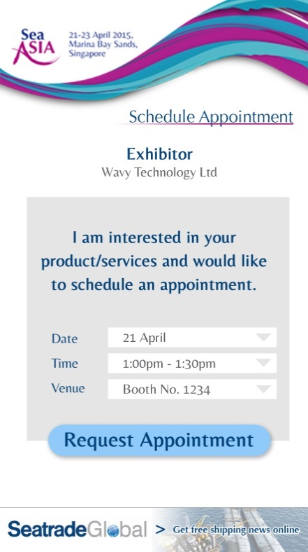
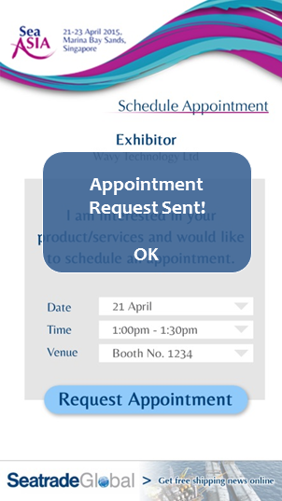
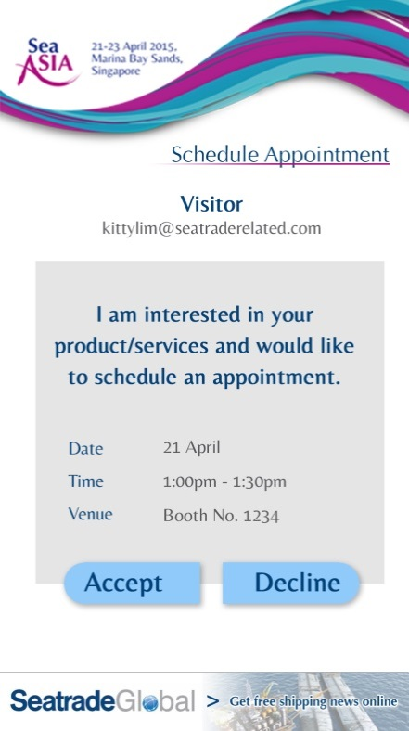
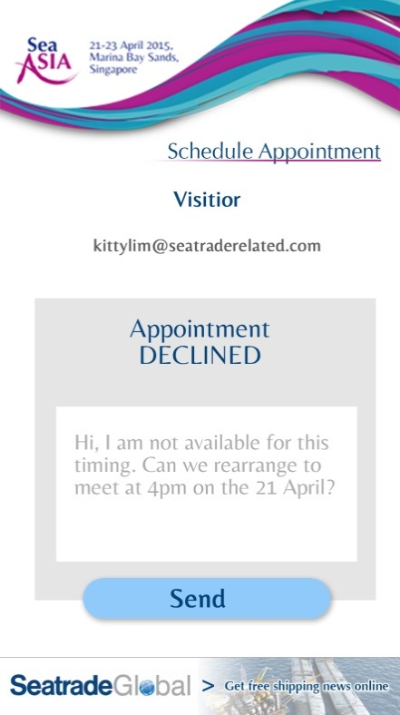
Conference
(Participants – Exhibitor List)
Visitor/Conference Delegate schedule appointment with Exhibitor
Exhibitor reply to appointment request
Delegate/visitor 会收到提示, 拒绝预约加入到”My itinerary – Business Matching (Pending Appointment)”
Delegate/visitor 会收到提示, 批准预约加入到”My itinerary – Business Matching (Confirmed Appointment)”
展商能输入评论。限制在160字符

Slide 10
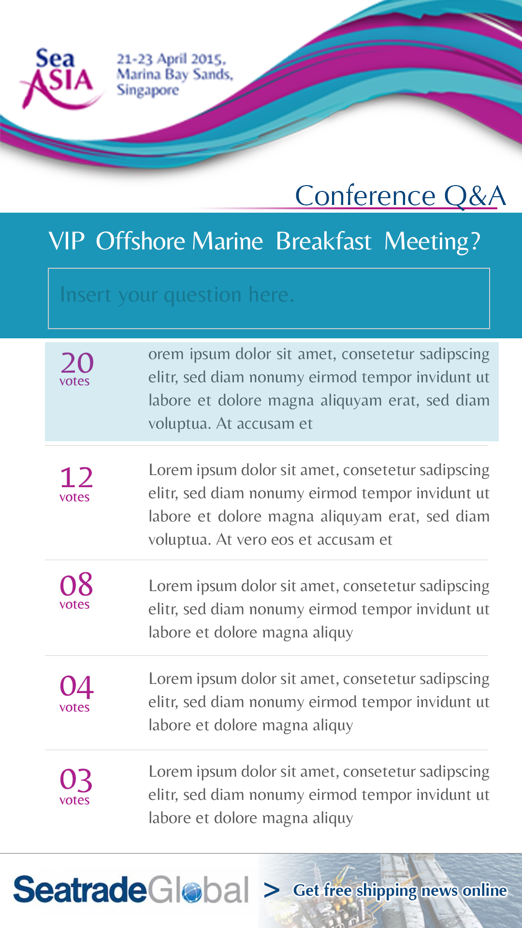
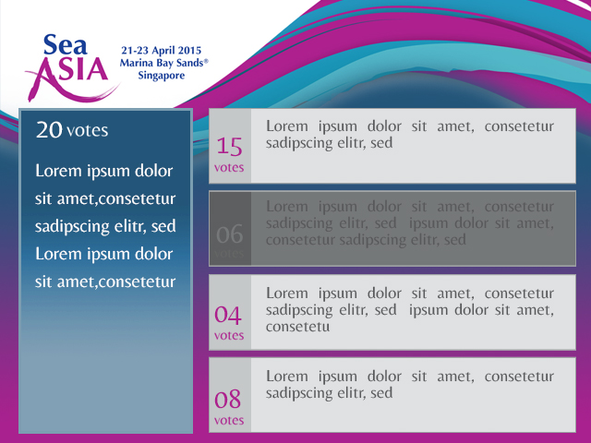
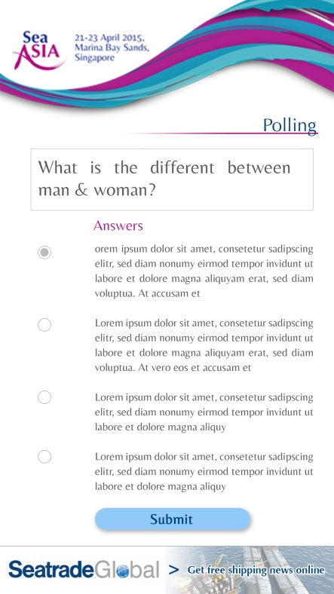

Conference Q&Av
Conference Polling

Slide 11
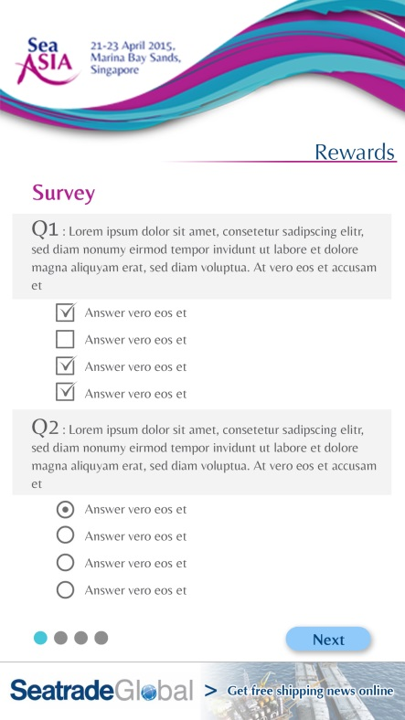
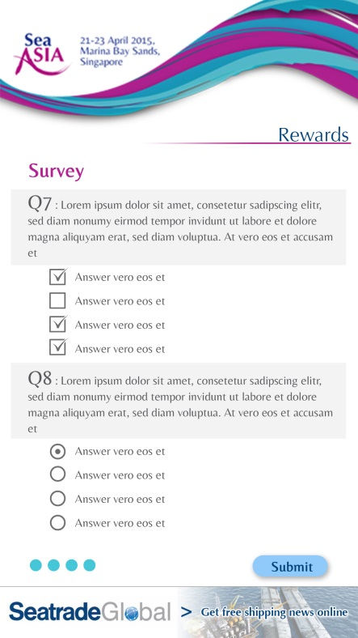

Conference Rewards - Survey
Conference – Conference Registration

Slide 12
Conference Rewards - Survey
Conference – Conference Registration
链接至客户网站

Slide 13
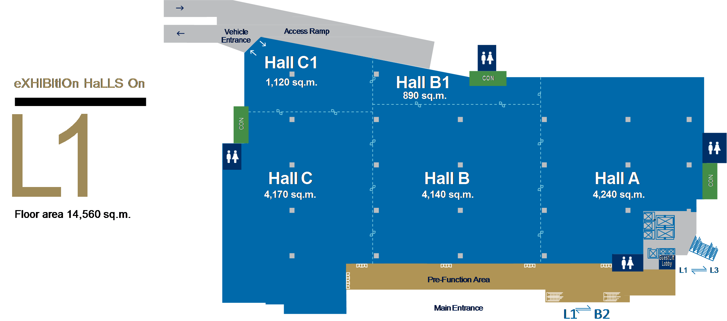
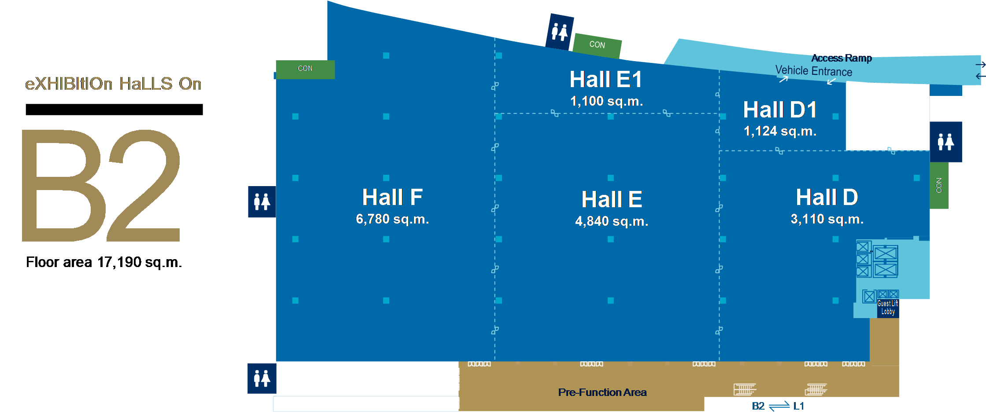
Floorplan – Level 1
Floorplan – Basement 2

Slide 14

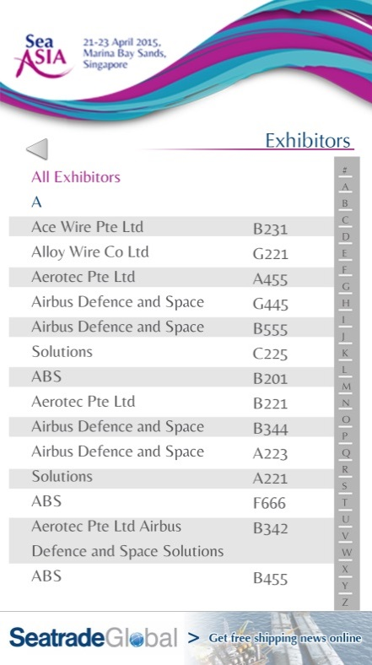


Exhibition – Exhibition Directory
Exhibition – Exhibition Seminar

Slide 15




Exhibition – Exhibition Directory
Rewards

Slide 16
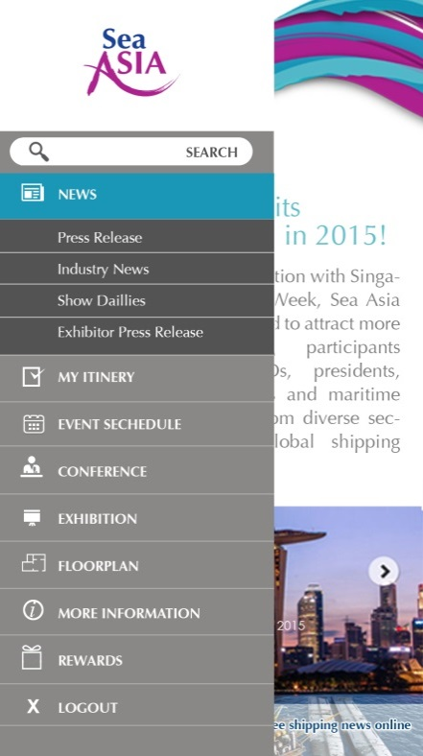
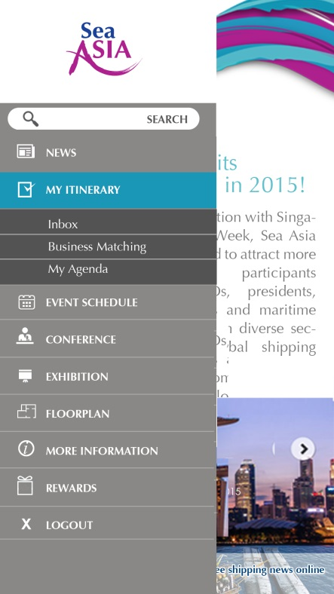
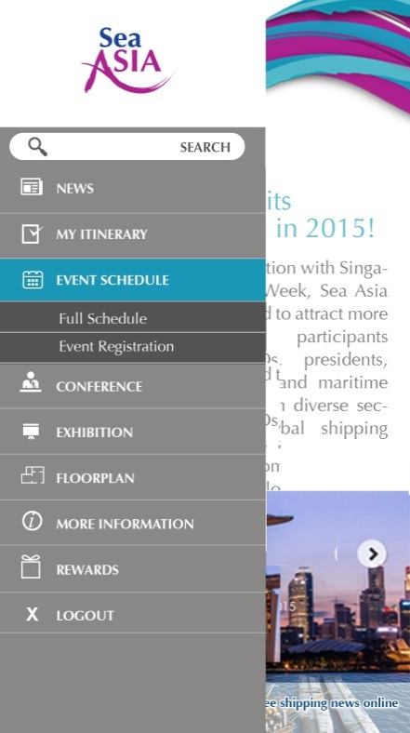
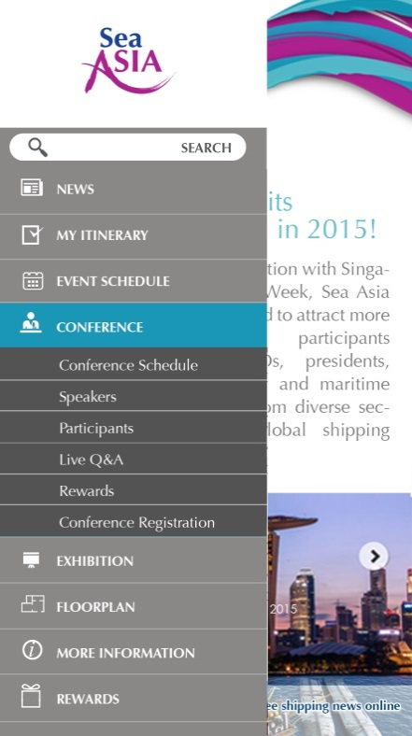
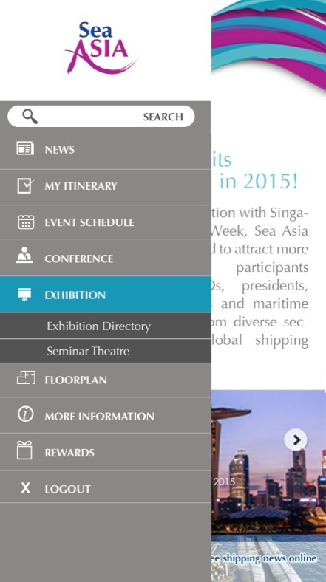
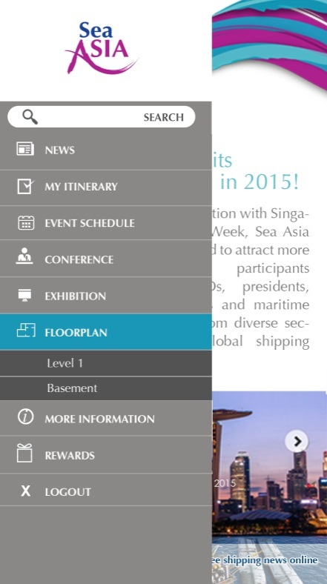
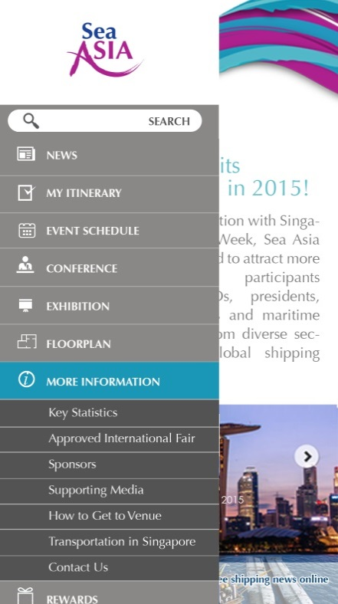
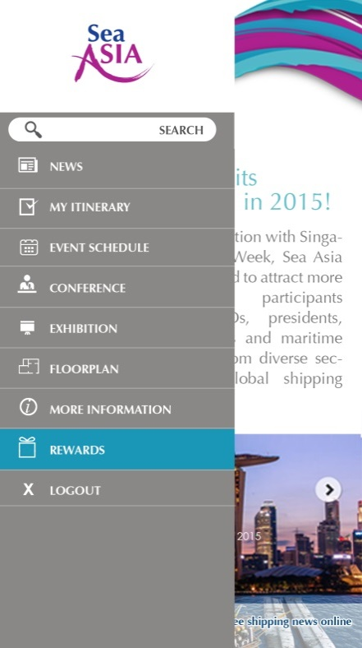
Side Menu (News)
Side Menu
(My itinerary)
Side Menu
(Event Schedule)
Side Menu
(Conference)
Side Menu
(Exhibition)
Side Menu
(Floorplan)
Side Menu (More Info)
Side Menu (Rewards)

